Slide 1
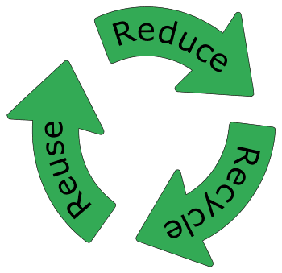
Plastics in romania
Students: Valeria Barbarii, Irinel Stefan, Dragos Radu, Victor Mihalas

Slide 2
Topics
What is plastic?
How is plastic recycled & plastic codes (detailed)
How far is Romania from the recycling targets imposed by the EU?
Consequences of non-recycled plastic

Slide 3
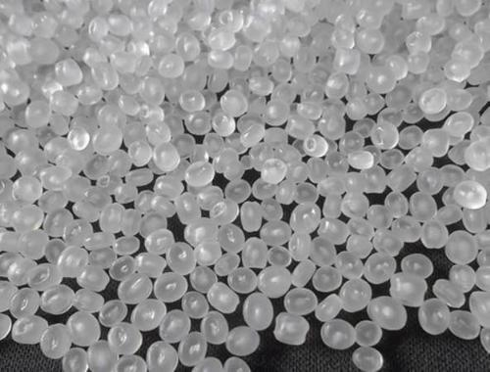
What is plastic?
Plastic, polymeric material that has the capability of being molded or shaped, usually by the application of heat and pressure. This property of plasticity, often found in combination with other special properties such as low density, low electrical conductivity, transparency, and toughness, allows plastics to be made into a great variety of products.
Polypropylene

Slide 4
How is plastic recycled?
Plastic that is collected from your homes, businesses and local recycling centres is sent to a Material Recovery Facilities (MRF), which separates plastic and non-plastic, or a Plastic Recovery Facilities (PRF), which sorts plastic by type. These facilites use sorting equipment such as an optical sorter which can distinguish between different types of plastics. The plastic then goes to a reprocesses where it is washed, shredded and sorted further. The plastic is then melted and extruded a into new recycled plastic pellets. These pellets are sold on for use in new products.

Slide 5
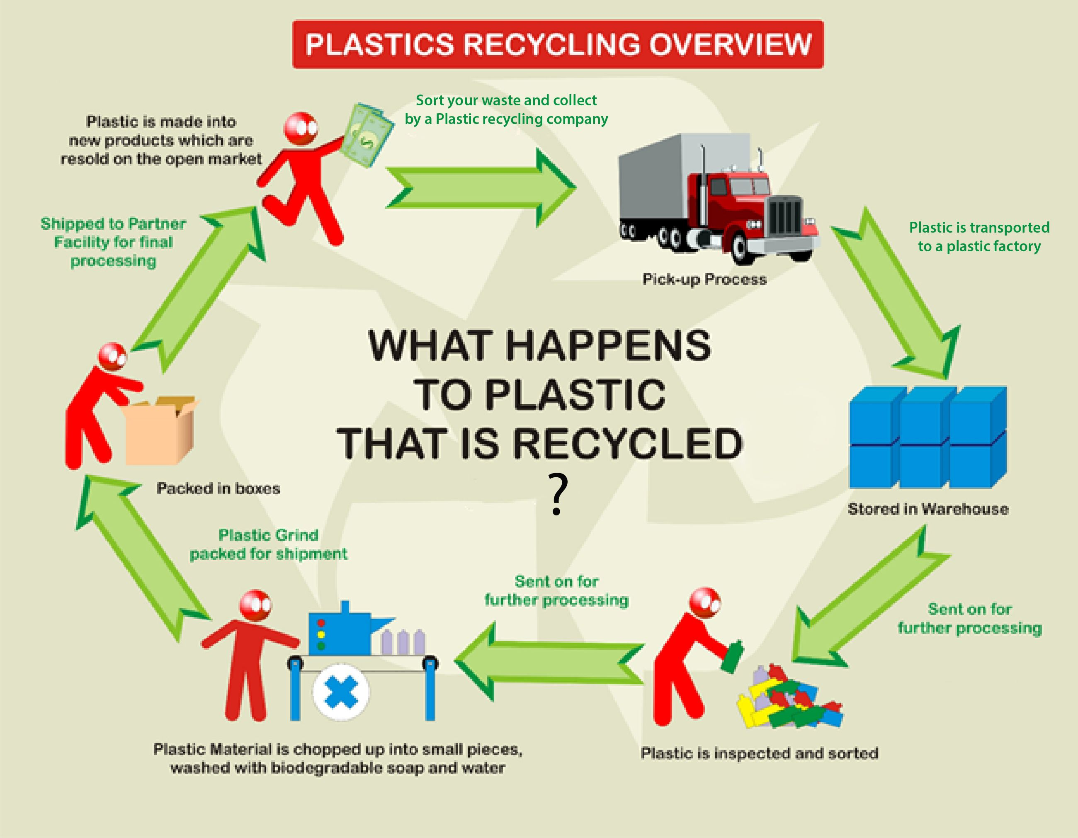

Slide 6
Plastic codes
PET (Polyethylene Terephthalate) ...
HDPE (High-Density Polyethylene) ...
PVC (Polyvinyl Chloride) ...
LDPE (Low-Density Polyethylene) ...
PP (Polypropylene) ...
PS (Polystyrene) ...
Other (BPA, Polycarbonate and LEXAN)

Slide 7
What do we know for sure?
We can say with certainty that in Romania all bottles can be collected for recycling - glass type containers from beverages (PET) or those from detergents, shampoo, conditioner (HDPE). If they are picked up by a sanitation operator, it is best to rinse and flatten them. If you take them to a vending machine (such as those in some supermarkets), you should know that it will only recognize PET vials (water and juice bottles) and will only receive them untreated, as they are automatically compressed in mechanism.

Slide 8
What is not recycled?
In addition to items with codes 1 and 2, there are also plastic products and packaging with codes from 3 to 7. They are either non-recyclable or harder to recycle.
Of course, there is always the possibility to find a collector who has managed to capitalize on these types of objects through recycling . However, as far as we know, most collectors either do not take them or take them to capitalize on energy, by incineration.

Slide 9
How far is Romania from the recycling targets imposed by the EU
Romania is at the bottom of Europe in terms of recycling, with a rate four times lower than the European average, reflecting the disastrous situation of waste management in our country. By 2020, Romania had to reach a 50% recycling rate in order not to be penalized by the European Union. This target has been missed, given that only 11% of municipal waste is recycled, making us the second lowest recycling rate in the EU. The next threshold must be reached in 2025, when Romania must reach a 55% recycling rate, a difficult goal for our country.

Slide 10
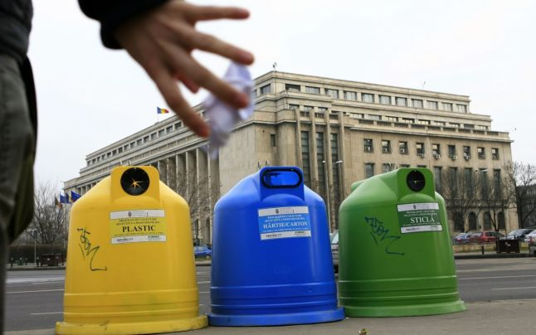
The way in which different materials are recycled in Romania

Slide 11
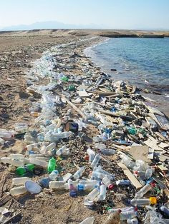
Consequences of non-recycled plastic
Pollution: Pollution affects the environment in several different ways. For example, when specific waste, such as Styrofoam, ends up in a landfill, the harmful chemicals seep into the soil, which can result in cancerous cells forming in the dirt. Neglecting to recycle plastic water bottles can pollute large bodies of water such as lakes, oceans and rivers.

Slide 12
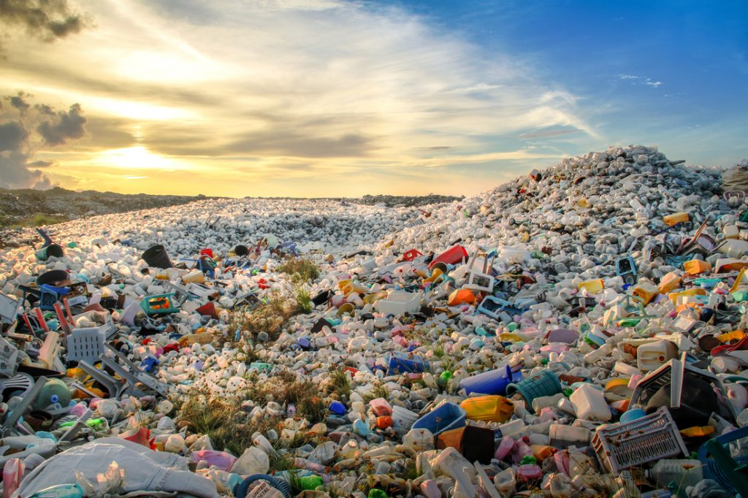
Overflowing Landfills: We all know that landfills are designed as a special place to deposit waste. But it’s no secret that as more of the population continues to neglect recycling, our landfills are going to continuously pile up, creating that unmistakable, foul smell we’ve all encountered and depositing harmful chemicals into the atmosphere.

Slide 13
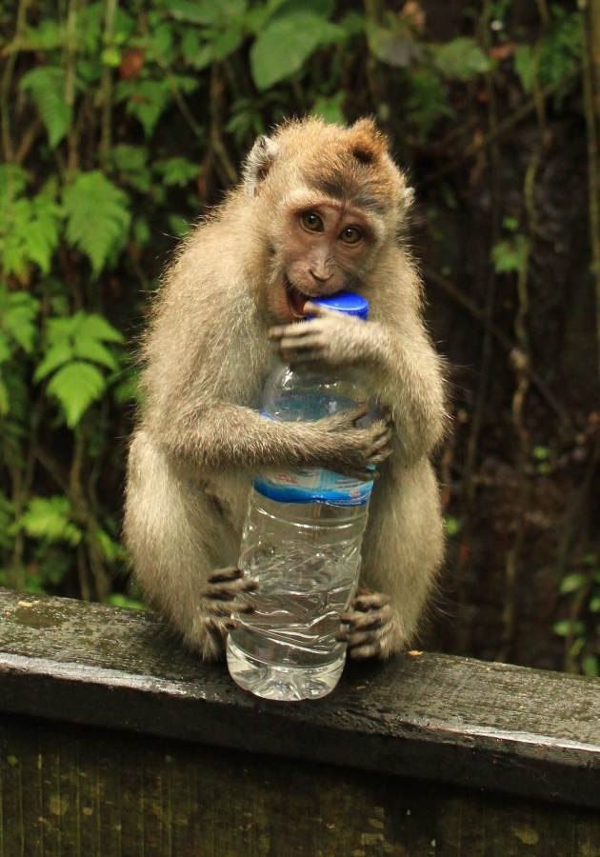
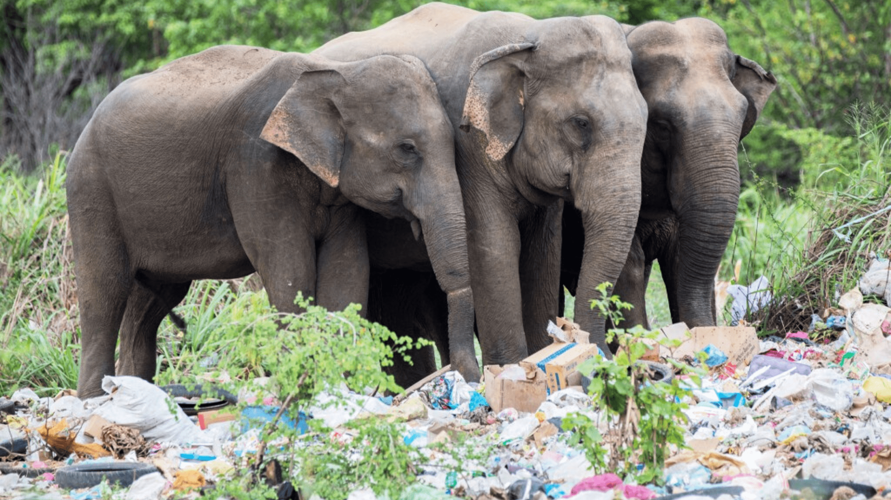
Natural Habitat Destruction: As landfills pile up, the earth can’t keep up with the amount of hazardous waste, resulting in the destruction of natural habitats.

Slide 14
Used links
https://hartareciclarii.ro/cum-reciclez/despre-reciclarea-plasticului-coduri-reguli-si-dileme/
https://adevarul.ro/news/societate/cat-romania-tintele-reciclare-impuse-uniunea-europeana-1_60fac09d5163ec42715f226a/index.html
https://learn.eartheasy.com/articles/plastics-by-the-numbers/
https://thisgirlabroad.com/how-to-survive-the-monkey-forest-in-ubud-bali/
https://blog.repurpose.global/what-is-the-effect-of-plastic-in-forests-and-wildlife/
https://ro.pinterest.com/pin/483151866249054070/
https://azimax.net/en/shop/polypropylene-pp-1300r-z30g/
https://sunrisesanitation.com/if-landfills-are-bad-whats-the-alternative/
https://ro.pinterest.com/yanaka2233/education/

